Slide 1


National Technological University. General Pacheco Regional Faculty
Zona Notebook
Company Profile
Subject: English
Student: Natalia Mucci
Date: November 15, 2024

Slide 2
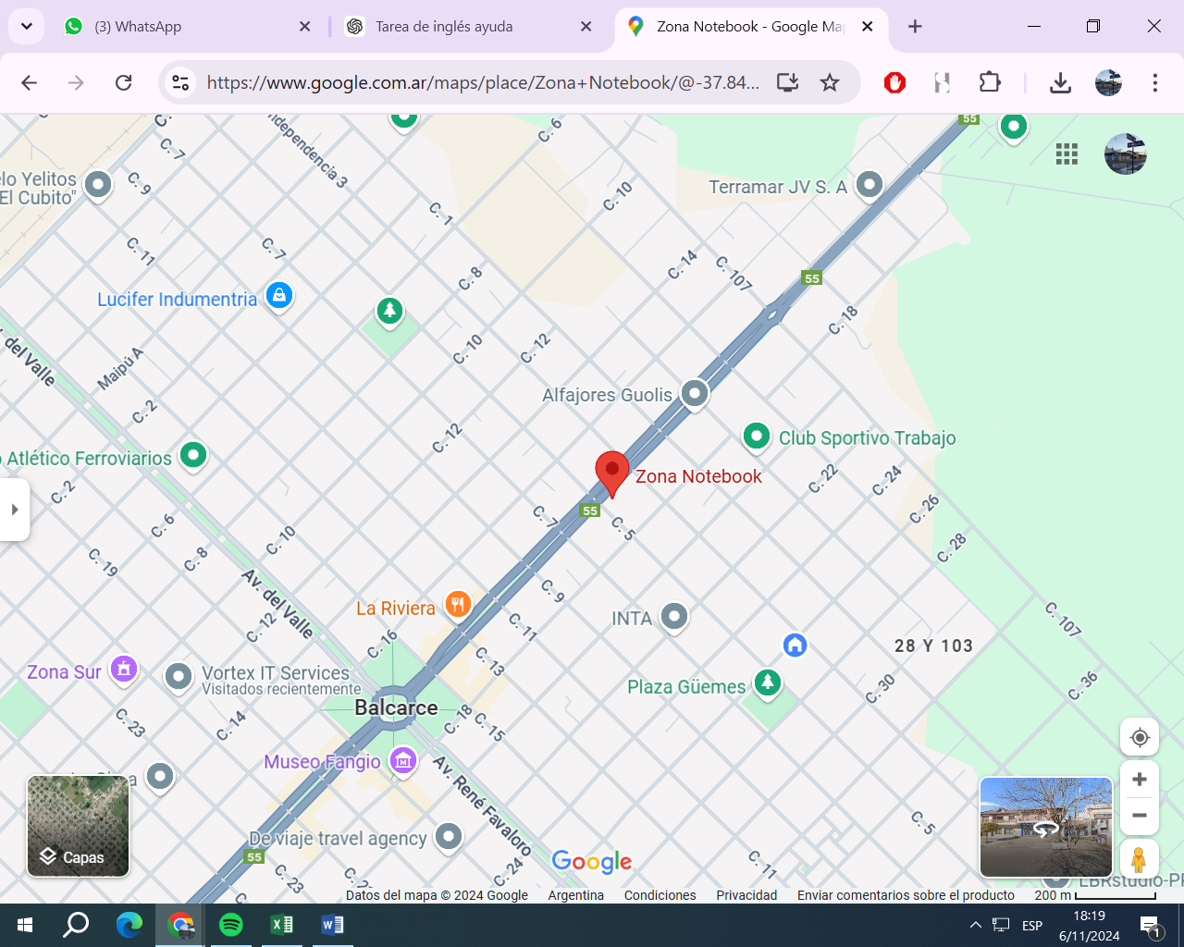
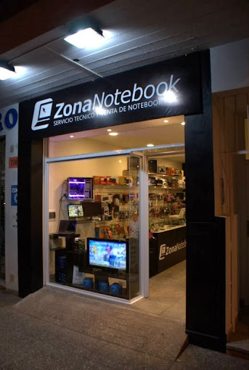
Zona Notebook
IT Company

Slide 3






National Technological University. General Pacheco Regional Faculty
Founded
Beginning
Expansion
Raúl and Francisco Felices
Technical support
Computer Repair Business
Computer Product Sales
Custom Software Development

Slide 4



National Technological University. General Pacheco Regional Faculty
Current Products and Services
Hardware and Software support
Sales of laptops, desktops, printers, and accessories
Custom applications(e.g., inventory systems).

